Slide 1

Week 5 - Homework
Immediate-mode mockup - the marquee console
Kai Hiori J Padilla
1

Slide 2
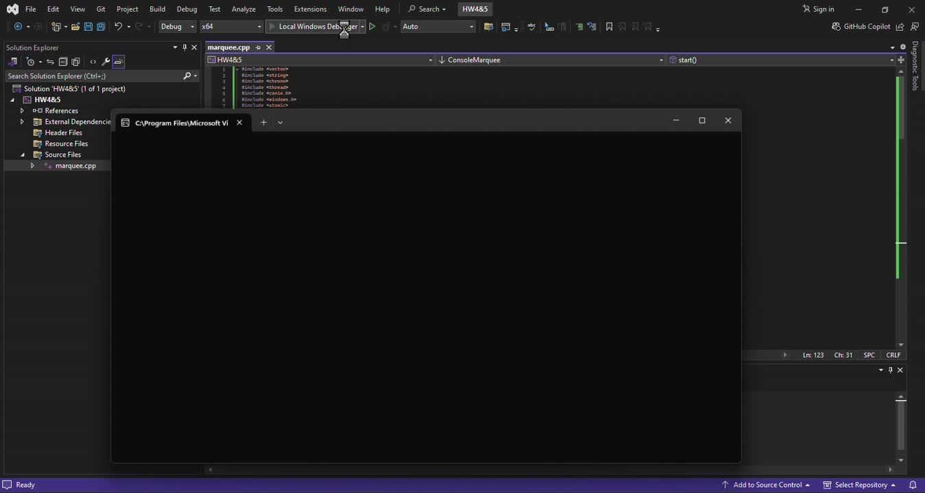
Video Demo
2

Slide 3
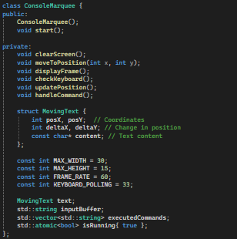
ConsoleMarquee
this encapsulates all the functionality needed to handle the marquee display, update its position, and process user input.
2

Slide 4
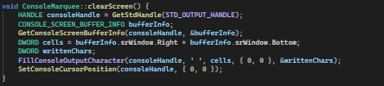
ConsoleMarquee::ConsoleMarquee()
Initializes the starting position and movement direction of the text object.
clearScreen()
clears the entire console screen
2

Slide 5

moveToPosition()
move the console arround a specific x and y coordinates
2

Slide 6
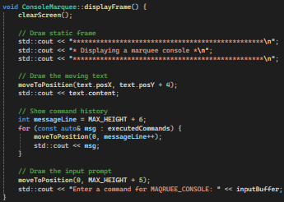
displayFrame()
this function handles the drawing and rendering of the current state of the console display.
2

Slide 7
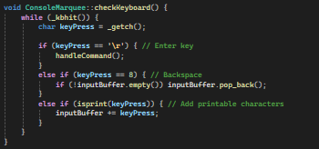
checkKeyboard()
function monitors and processes keyboard input from the user.
2

Slide 8
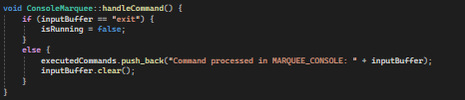
handleCommand()
function processes the user inpu
2

Slide 9
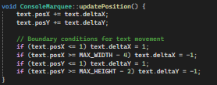
updatePosition()
this function updates the moving text in the marquee
2

Slide 10
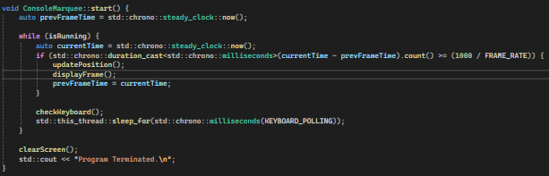
start()
this function contains the main loop for running the marquee
2

Slide 11
End of slides
3

